Slide 1
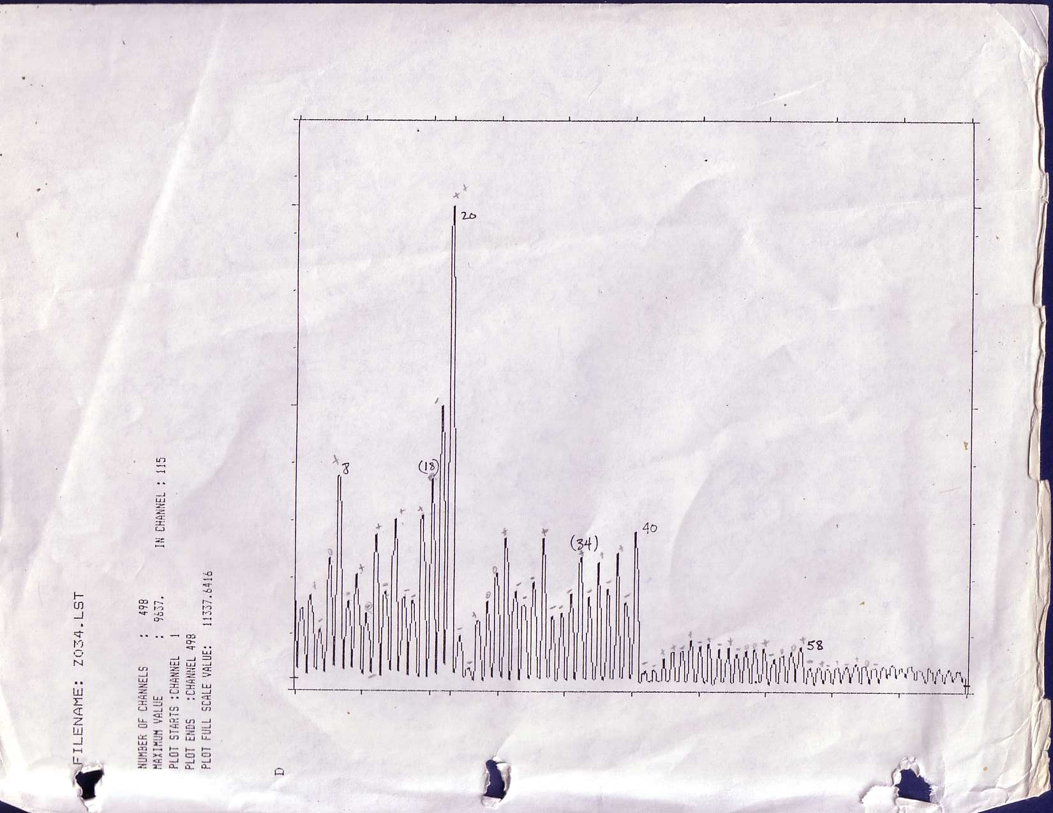
Electronic Shell Structure in Metal Clusters
Walt de Heer

Slide 2
The pre-shell structure years

Slide 3
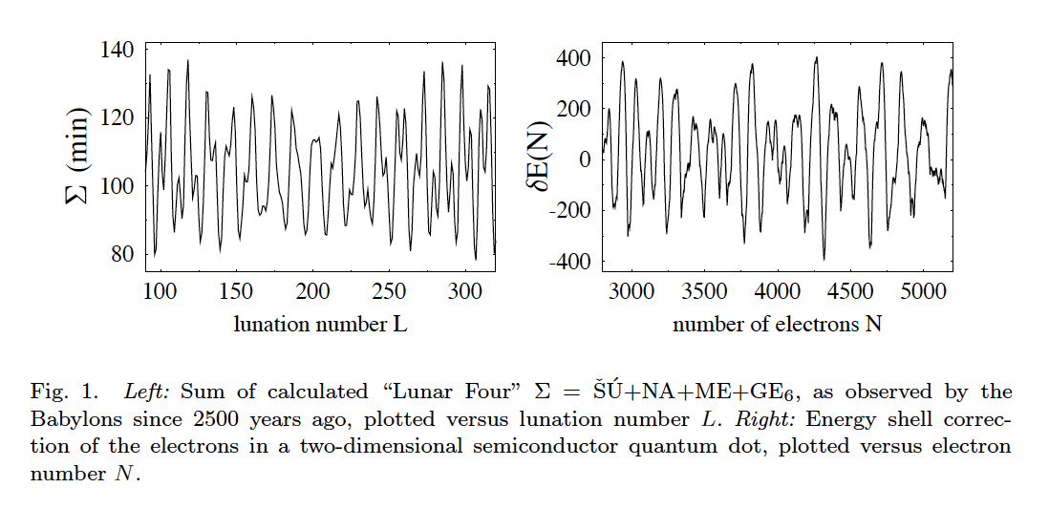

Slide 4
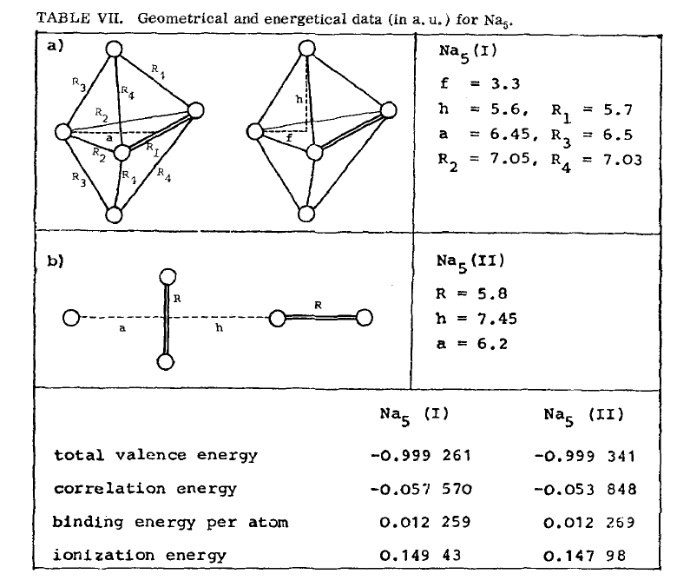
1970’s Sodium clusters are molecules

Slide 5
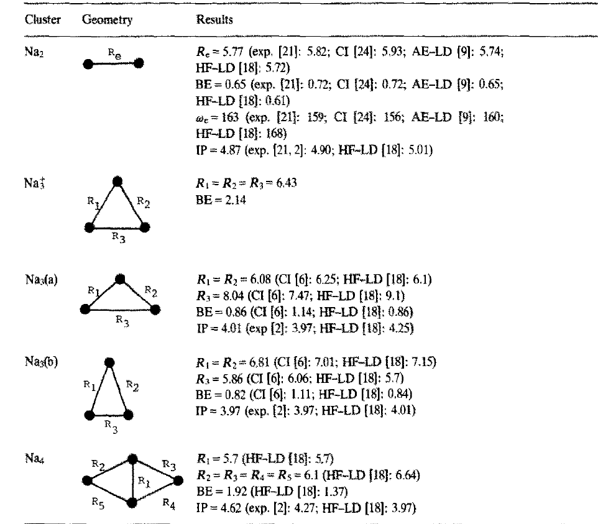
Great idea: Clusters are molecules that can be calculated using density functional theory

Slide 6
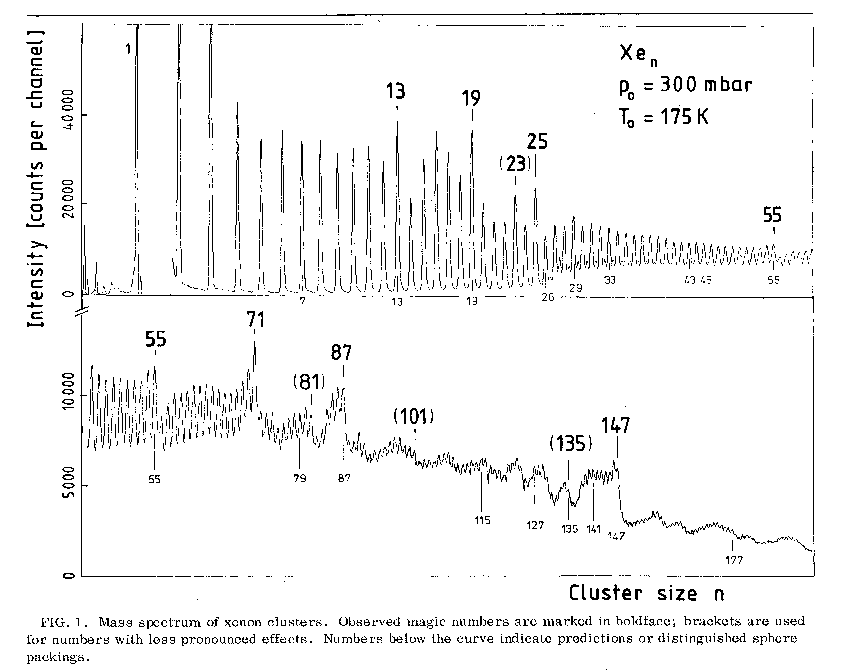
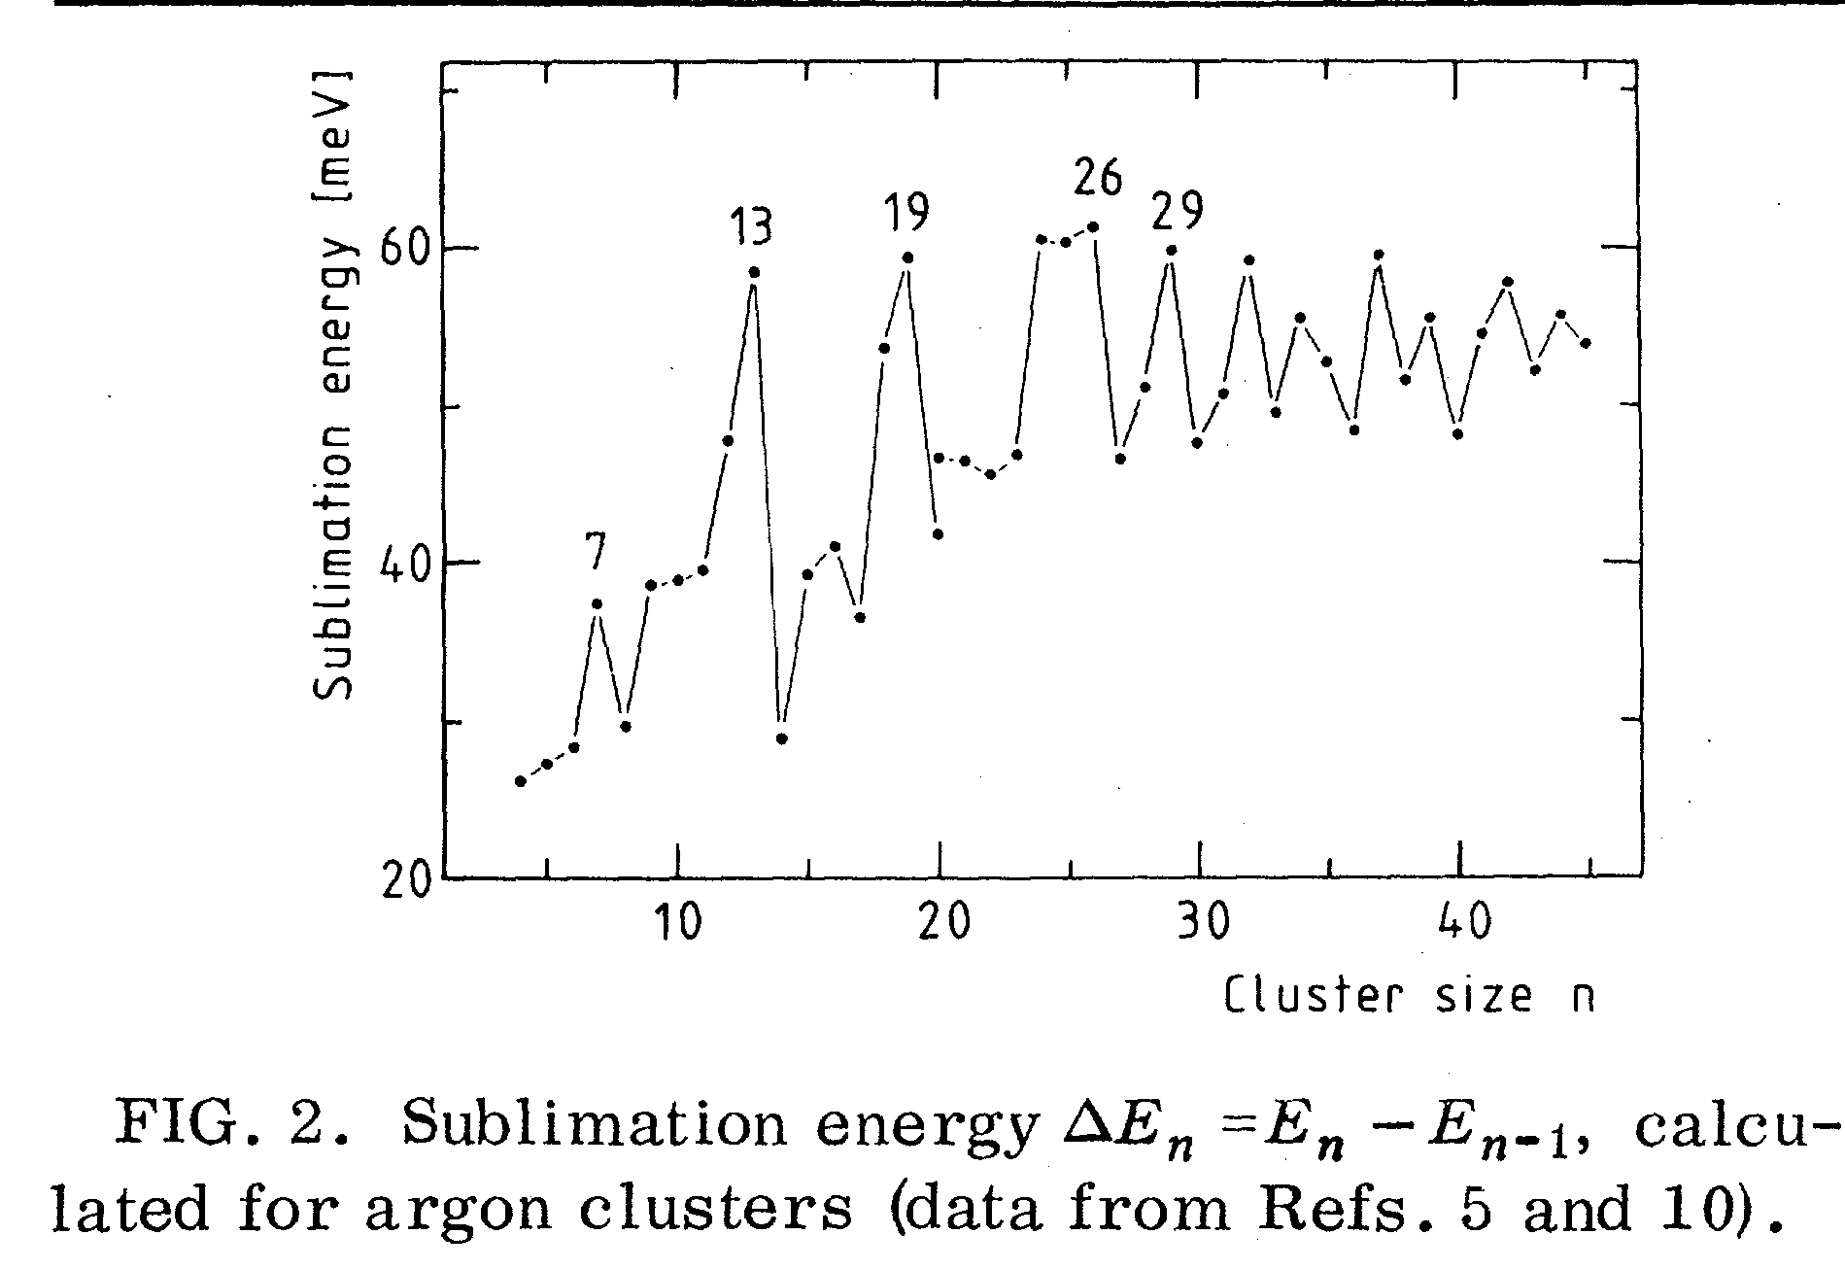
Mass spectra mean something
Magic numbers: stability and structure

Slide 7
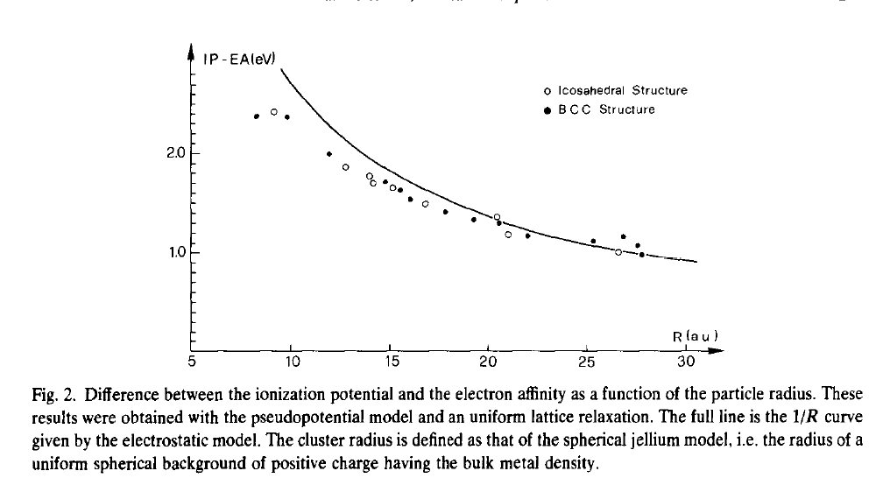
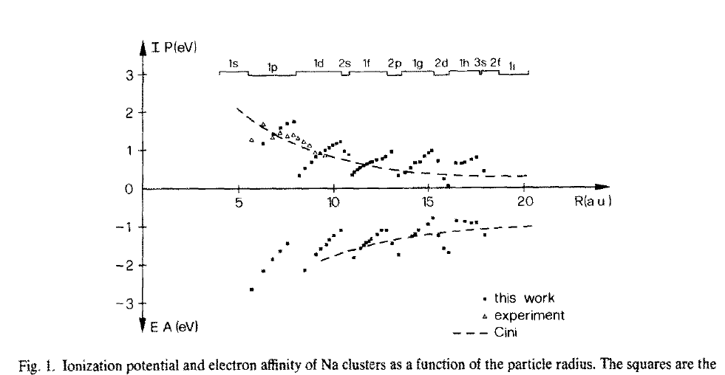
Spherical jellium droplets: does it mean anything?

Slide 8
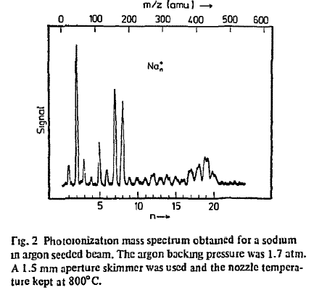
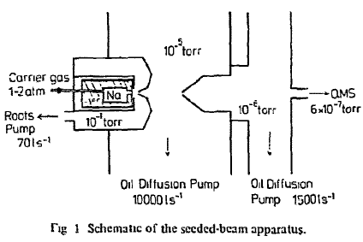

Slide 9
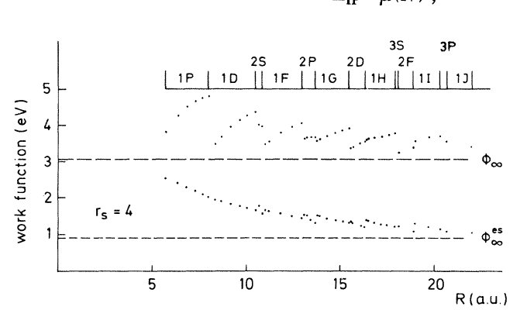
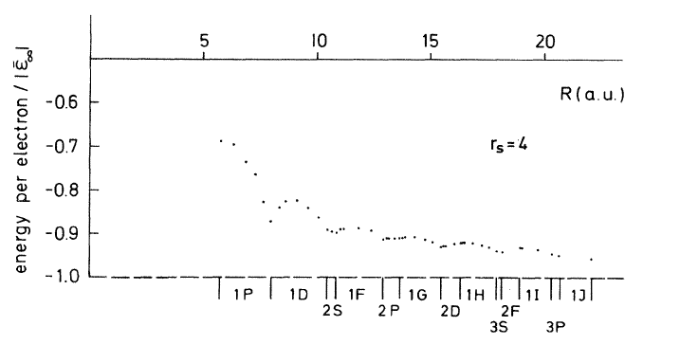
Spherical jellium is an interesting idea!

Slide 10
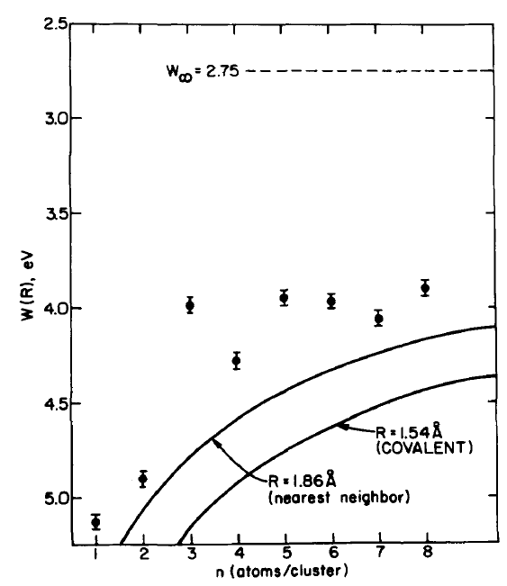
Spherical metal droplets is a bad idea!

Slide 11
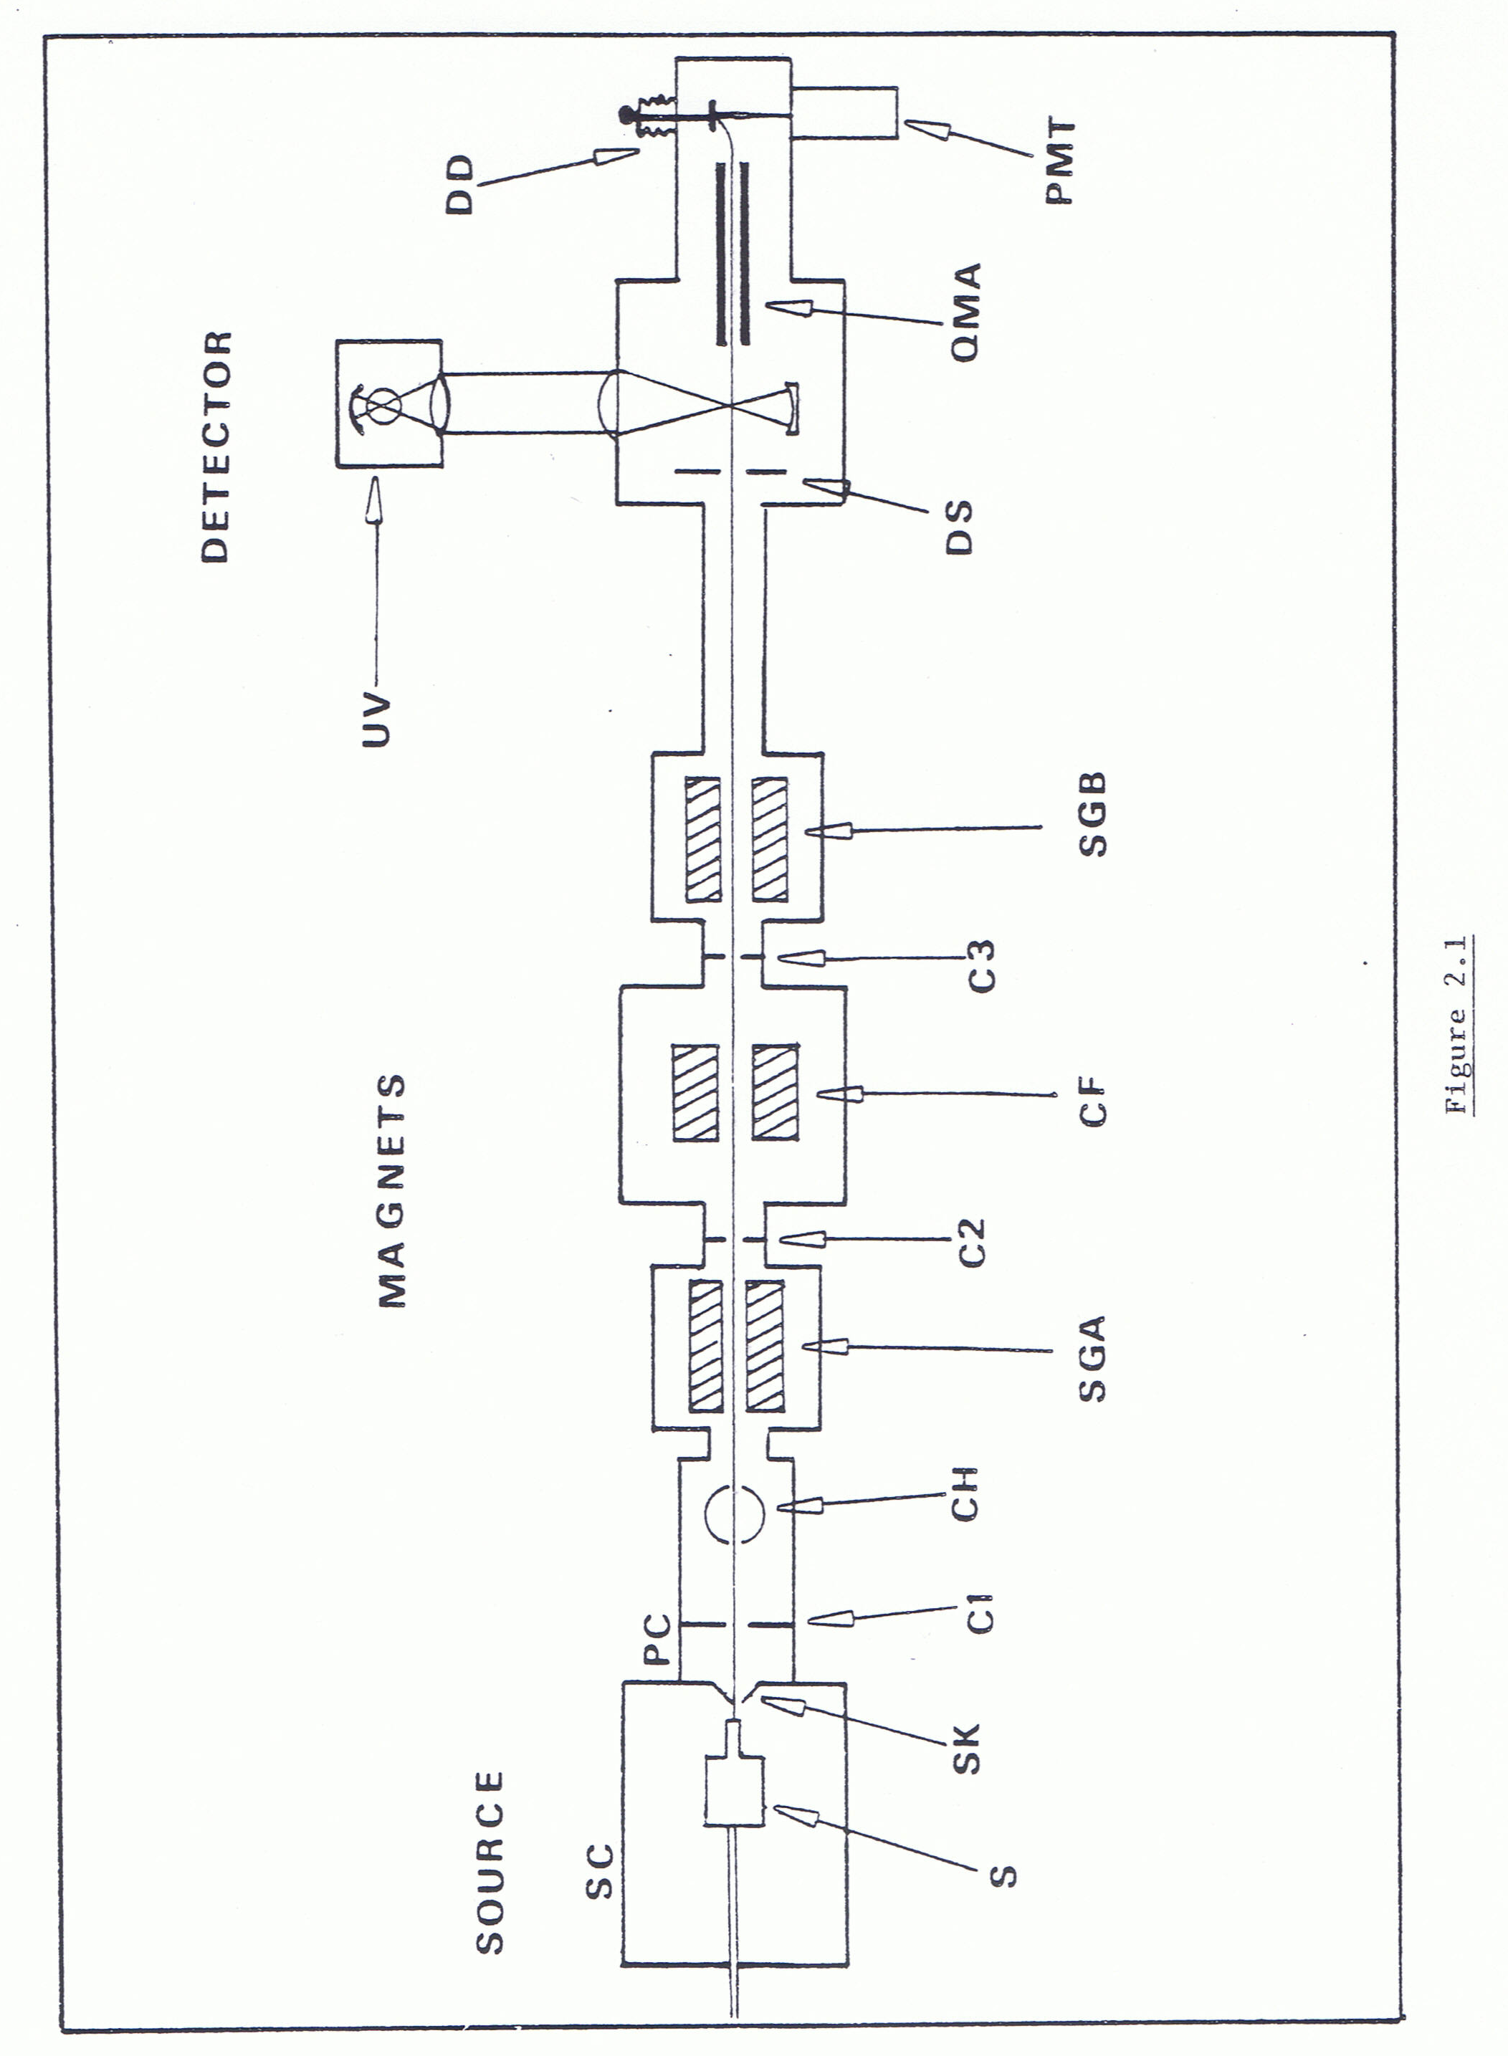
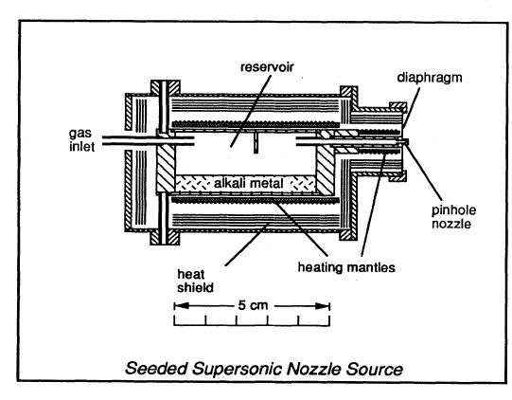
Knight’s idea: molecular beam resonance experiments on very small clusters to explore “quantum size effects”.
De Heer PhD thesis 1985

Slide 12
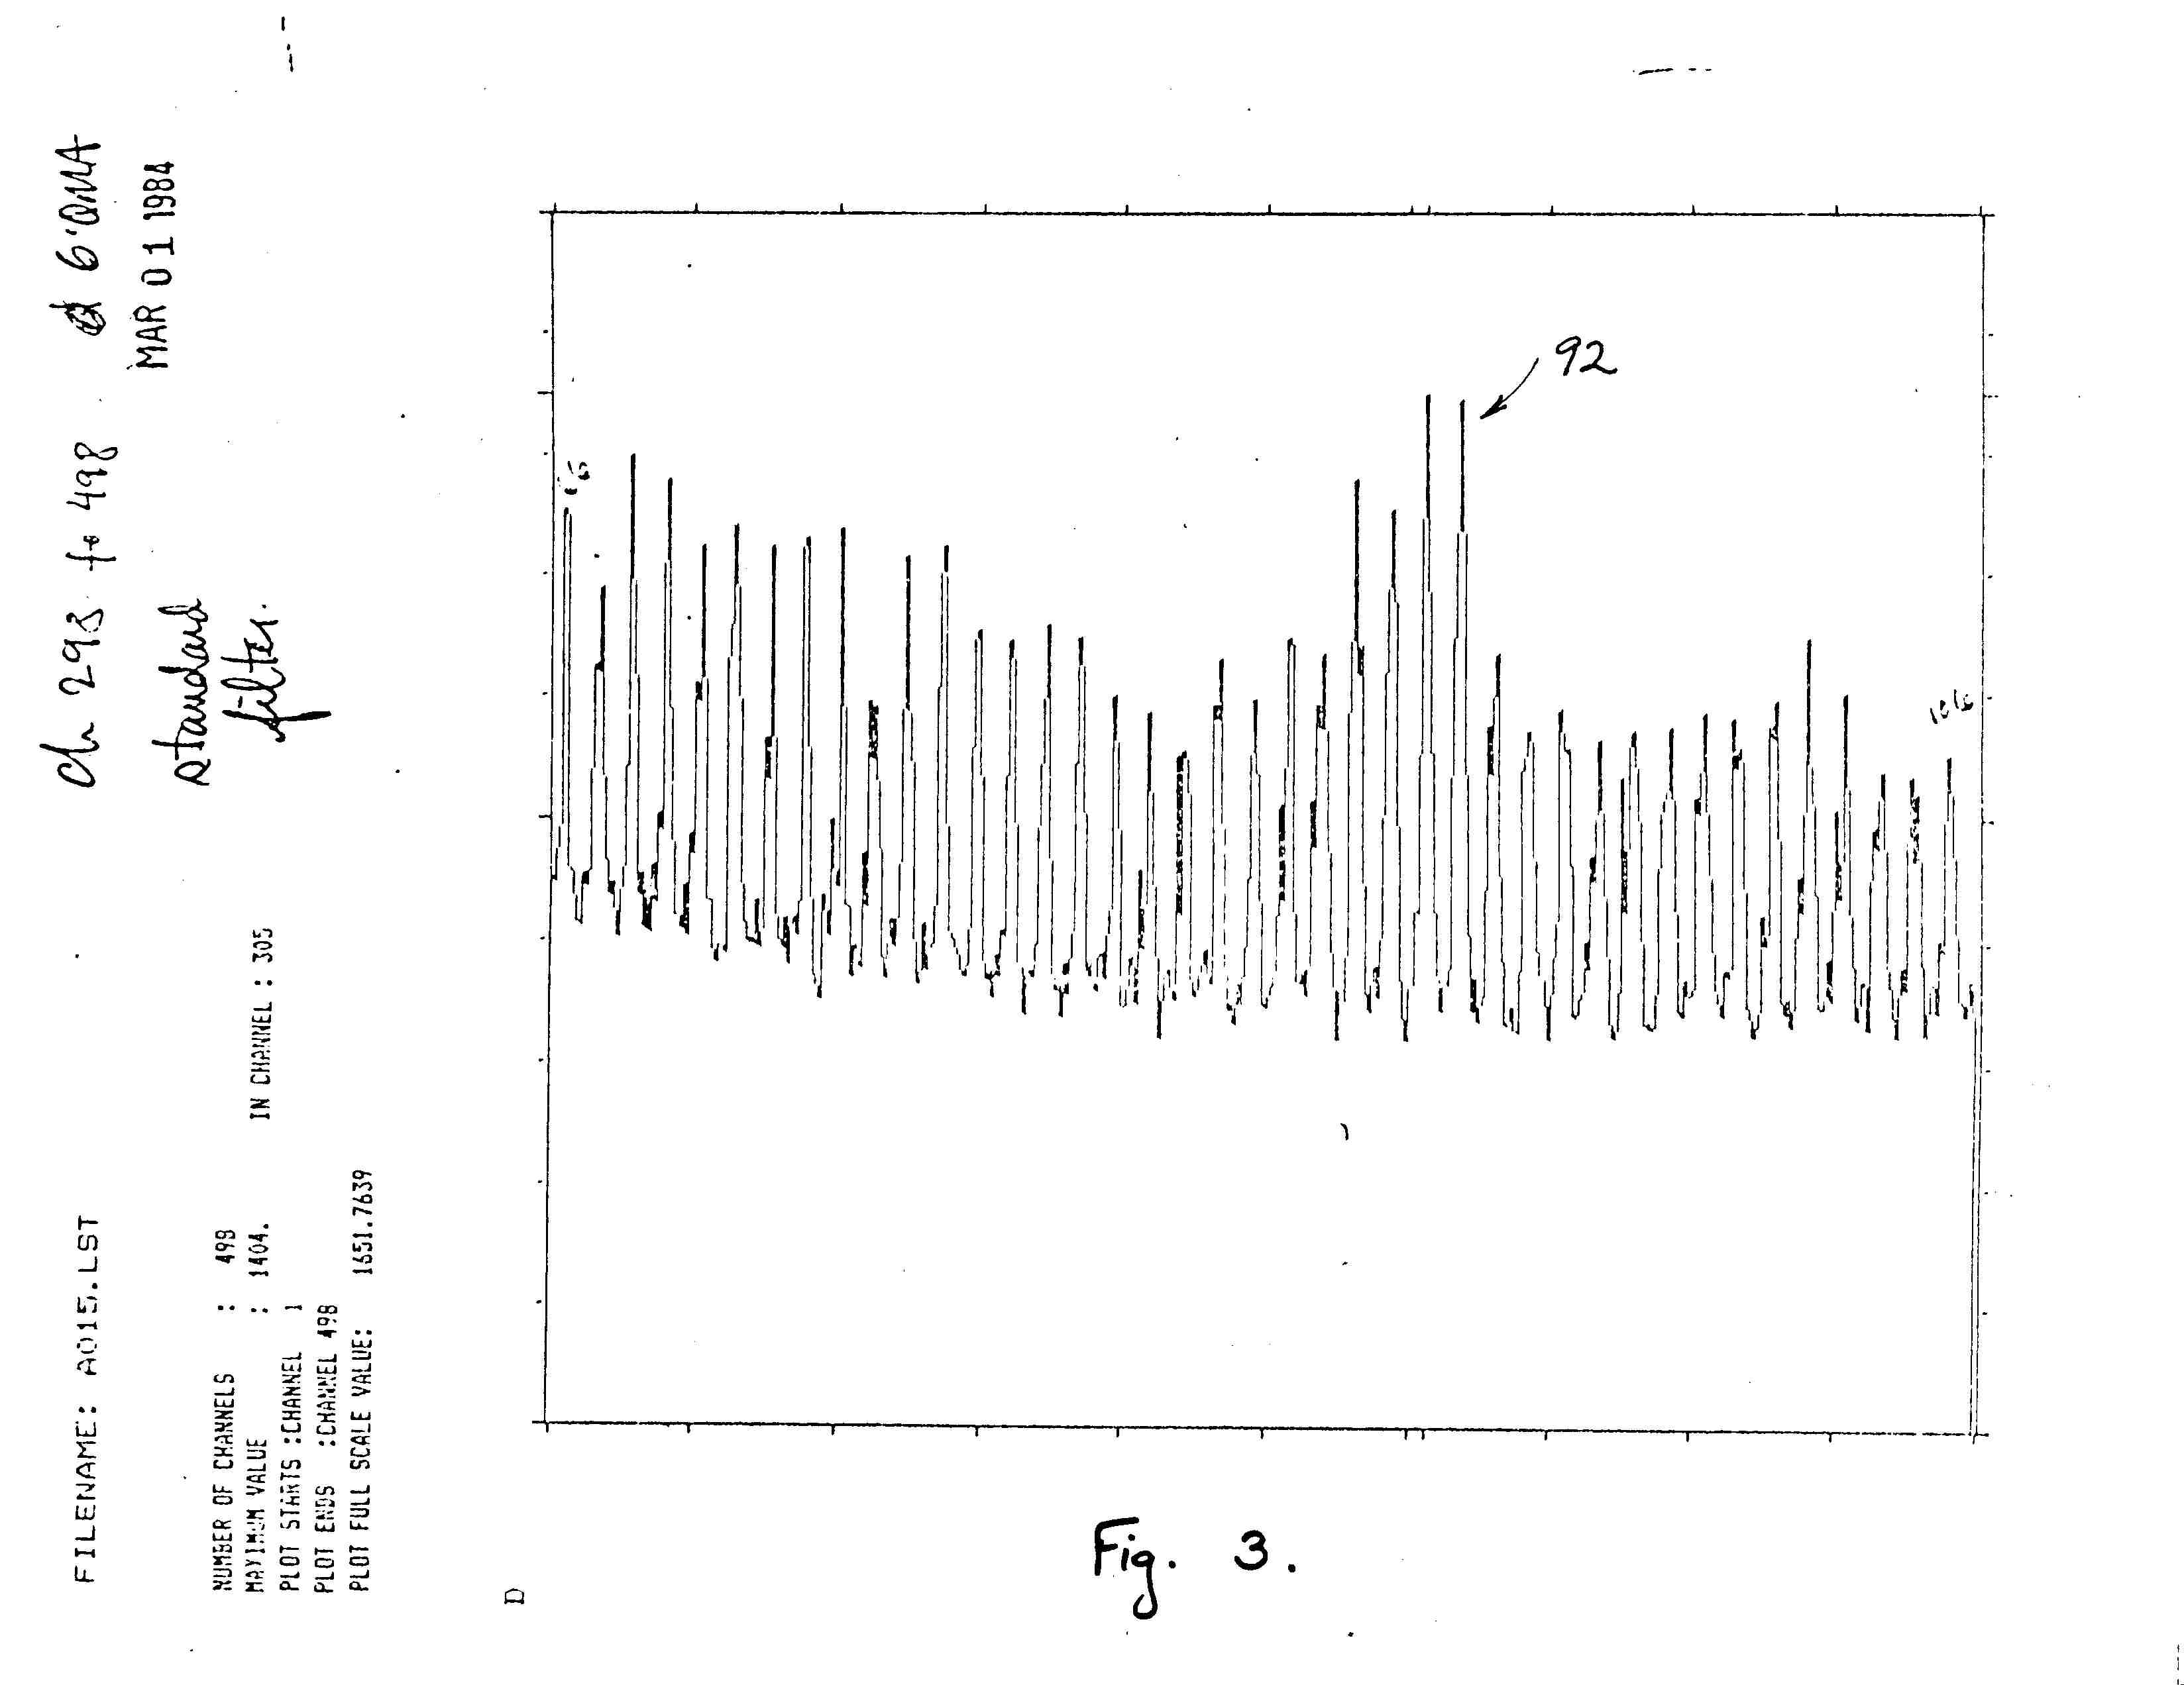
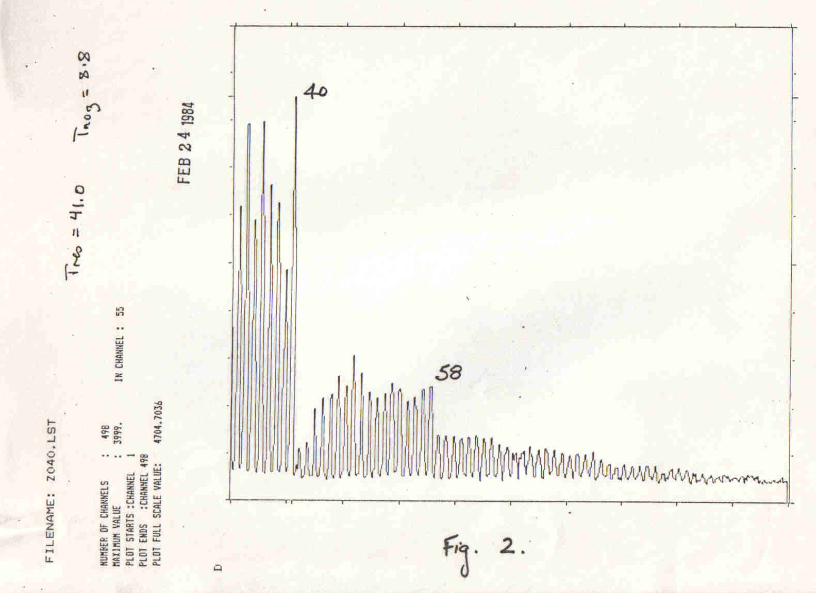
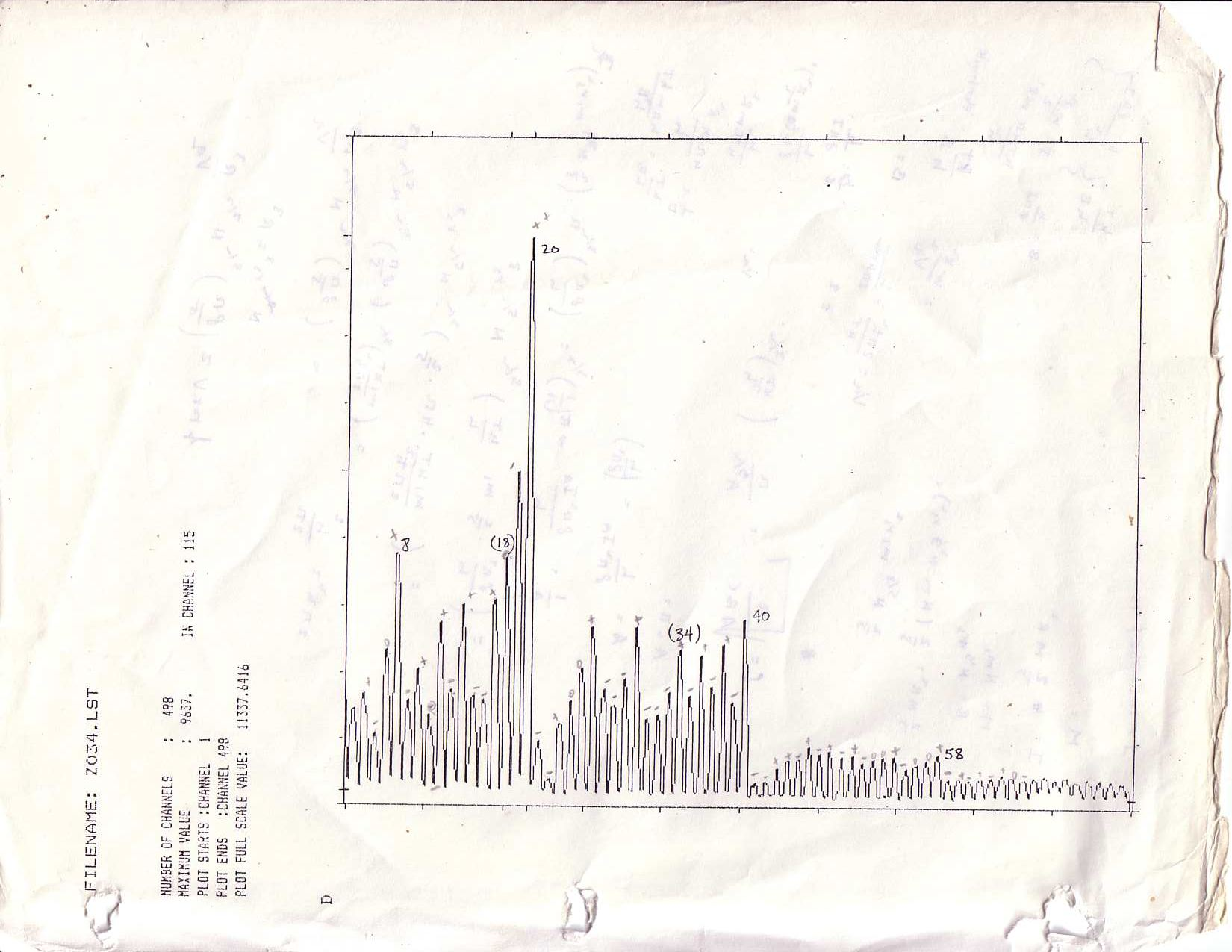
For a brief and accurate account of the discovery, see
Science News, July 19, 2008 by Walt de Heer, Keith Clemenger,
Winston A. Saunders, in response to story in
Science News, June 21, 2008

Slide 13
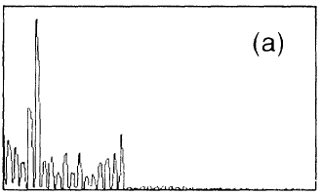
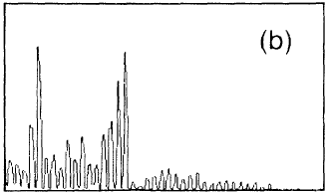
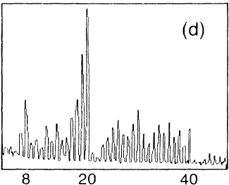
First indication of shells: the spectra evolve shell-by-shell.
Increasing carrier gas pressure
(increasing cooling)
Knight et al PRL 52, 2141 (1984),

Slide 14
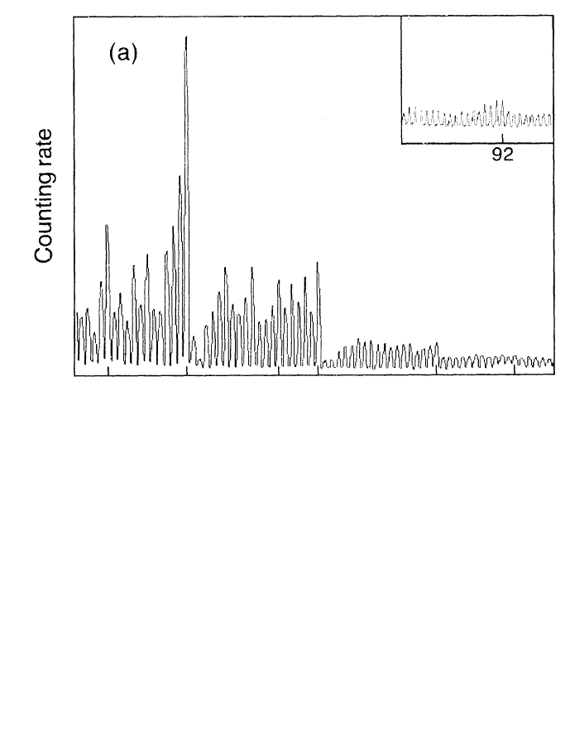
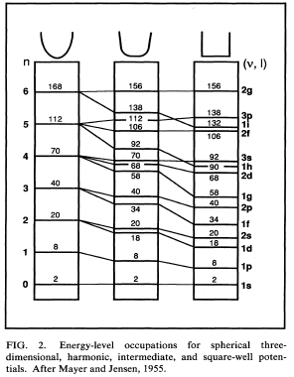
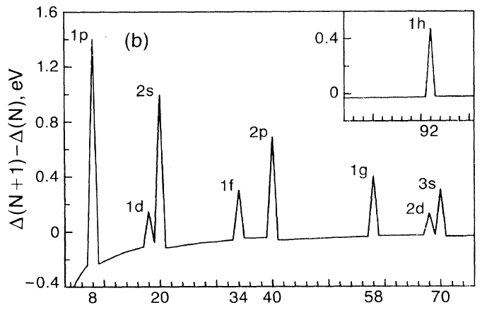
Spherical potentials (delocalization)
20
92
8
40
58
Spherical potentials: produce shells, but discrepancies remain (spherical symmetry).
“Woods-Saxon” potential(not Jellium)
De Heer, Rev. Mod. Phys. 65 1993 611
Knight et al PRL 52, 2141 (1984),

Slide 15
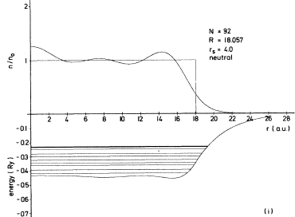
The spherical jellium model
Electronic density
Jellium (ionic) radius, R_{ion}
R_{ion}
Δ
Screening radius, R_{ion}+ Δ
Δ
Electronic “Spillout”
Spherical positive (jellium) background
E_{Fermi}
Levels near Ef spill out beyond the jellium
W. Ekardt PRB 29, 1558 (1984)
+ Electronic structure in a positively charged sphere solved self consistently.
+ It “builds in” metallicity.
Does not resolve shell discrepancies
Is not exactly “simple”

Slide 16
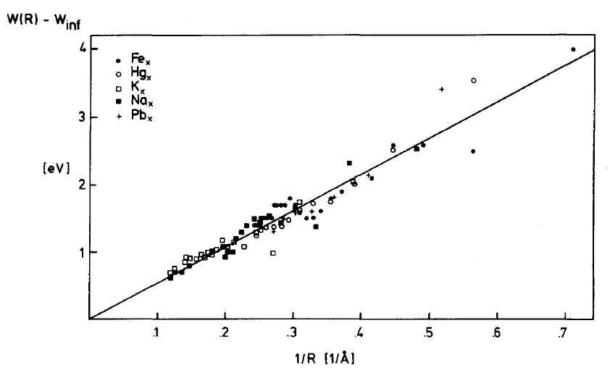
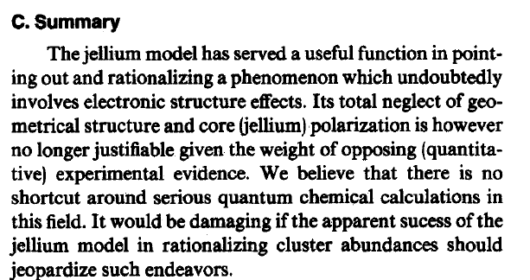
Schumacher: Shell structure is right
but spherical jellium is not a good model.
Upshot: all metal clusters show metal droplet behavior, but the spherical jellium model is a poor starting point.

Slide 17
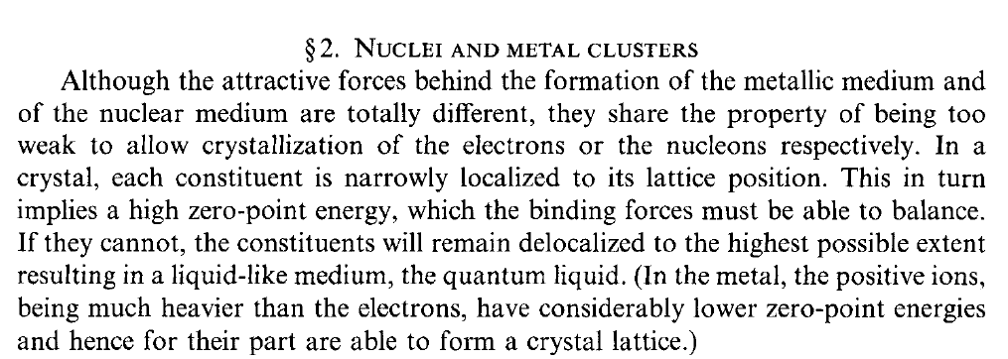
Deep insight into the physics behind the shell stucture.
S. Bjornholm, J. Borggreen
Philosophical Magazine B, 1999 , 79, 1321
But is it a Physicists point of view!

Slide 18
That can be summarized as follows:
Alkali clusters are like fish in a liquid droplet
ions
electrons
The liquid, not the fish determines the shape of the droplet!

Slide 19
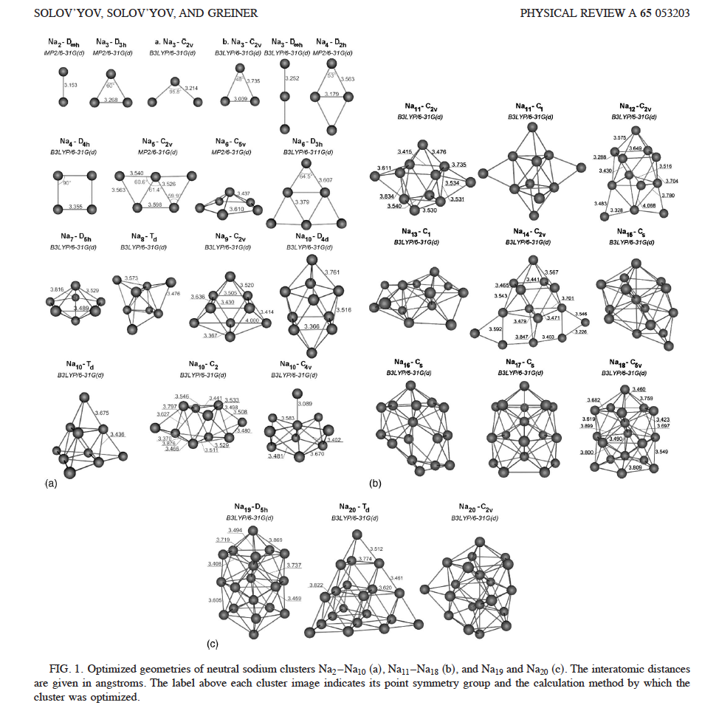
This is what they really look like, by the way…

Slide 20
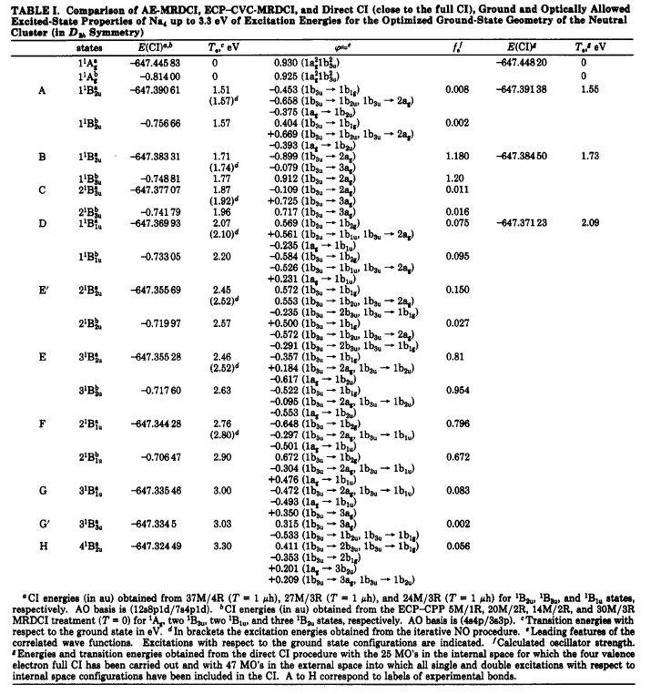
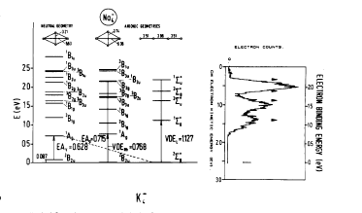

Slide 21
The great divide:
Cluster physics versus cluster chemistry
Forest versus trees.
The Physicist wants a description of the physical properties from the atoms to the bulk, concentrating on trends.
The Chemist wants an accurate description of the chemical properties, concentrating on individual clusters.
(Also not the great confusion:
Shell structure versus the jellium model)

Slide 22
Shell structure versus the Jellium model
Shell Structure
The property of [metal clusters] that [valence electrons] occupy quantum states which are in groups of approximately the same energy, called shells, the number of [valence electrons] in each shell being limited by the Pauli exclusion principle.
[nuclei, atoms, metal clusters]
[similar nucleons, electrons, valence electrons]
Model
A model is a simplified description of the complex reality designed to reveal the main workings of a system.
Shell structure is a property, not a model!

Slide 23
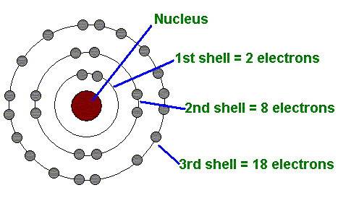
Atomic Shell Structure
Simplest Model: Coulomb potential (Bohr atom)
Aufbau with independent electrons.
First order corrections:
Many-body effects (screening):“Hunds Rules”;
Shell closings (Periodic Table): 2, 10, 18, 36, 54, 86

Slide 24
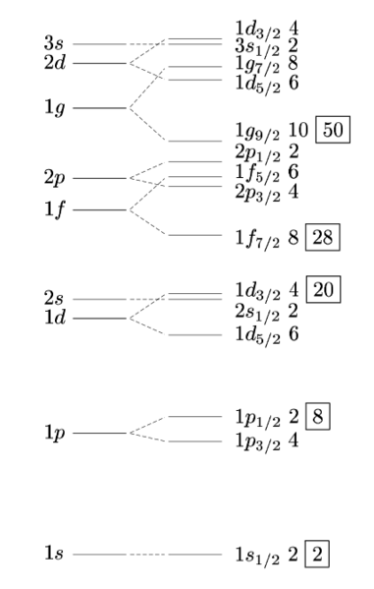
Nuclear Shell Structure
Simplest model:
3D harmonic potential;
Independent nucleons;
Magic Numbers: Σ(n+1)(n+2)
→ 2, 8, 20, 40, 70, 112
First order corrections:
Spin-orbit coupling (Goeppert Mayer)
Rounded well (Woods-Saxon)
Ellipsoidal distortions (eg Nilsson)
Shell closings (Magic Numbers):
2, 8, 20, 28, 50, 82, 126
70
40
20
8
2
Woods-Saxon
Spin-Orbit
Harmonic

Slide 25
Shell Structure in Alkali Clusters
Simplest model:
3D isotropic harmonic potential
Independent electrons
Magic Numbers: Σ(n+1)(n+2) → 2,8,20,40,70,112)
First order corrections:
Rounded ellipsoidal well (Nilsson-Clemenger)
Major Shell closings: (2, 8, 20, 40, 58, 92)
Sub Shell closings: 10,14,18, 26,30,34,50,…

Slide 26
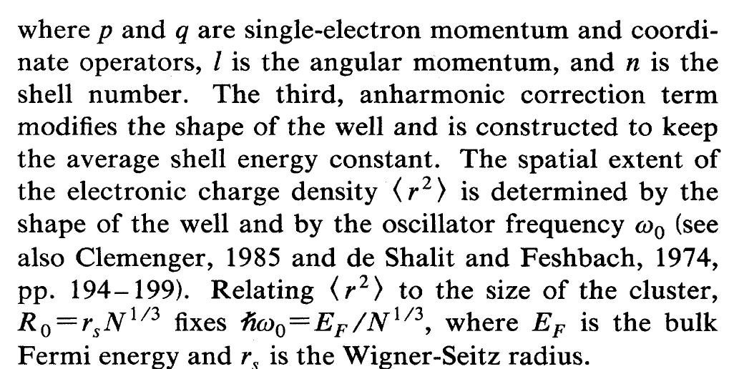
Nilsson Hamiltonian (spheroidal model)
Harmonic oscillator potential
Anharmonic correction
p, q single-electron momentum and position
l: angular momentum
U: anharmonic amplitude
n: shell index

Slide 27
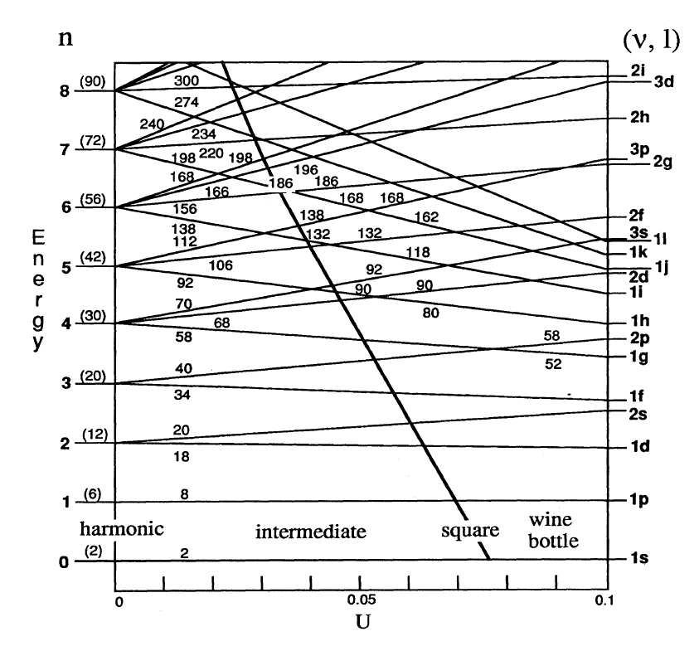
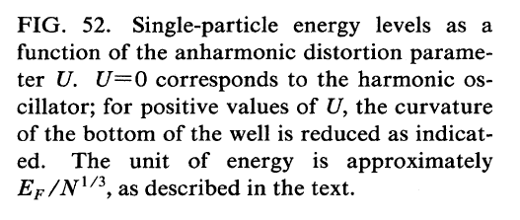
Anharmonic spheres

Slide 28
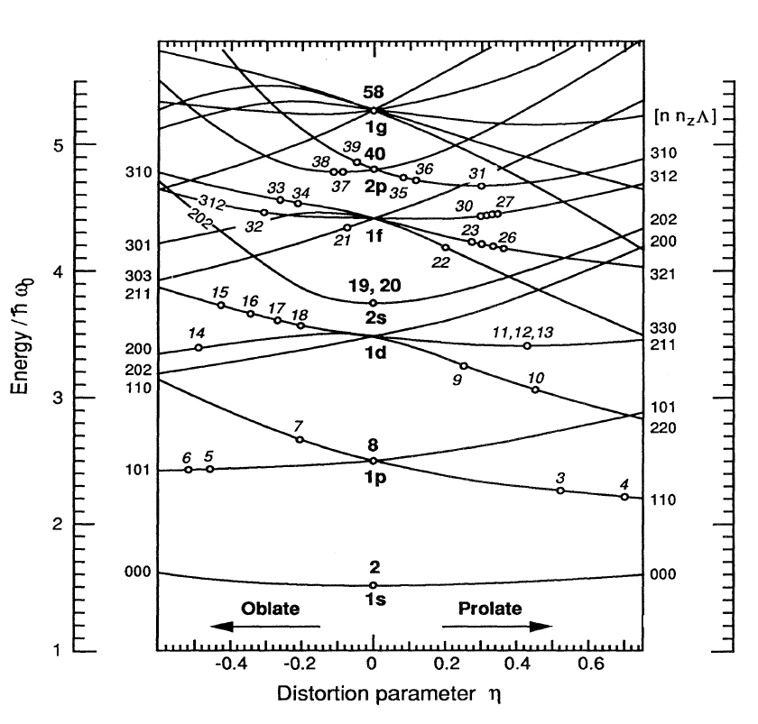
Anharmonic spheres with spheroidal distortions

Slide 29
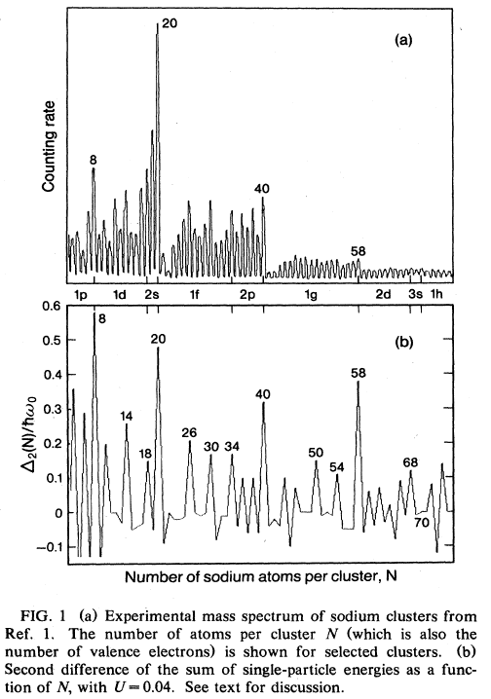
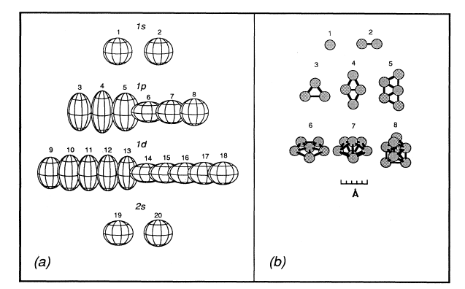
Spheroidal electron droplet model
Cluster shapes are determined by the electronic structure
14
18
26
30
34
50
54
Clemenger, PRB 32 1359 (1985)
+ Simplified description that reveals the main workings
+ Resolves shell edge discrepancies of spherical models.

Slide 30
3D harmonic oscillator model with ellipsoidal distortions (easy to calculate)
R_{z}
R_{y}
R_{x}
Single particle energies

Slide 31
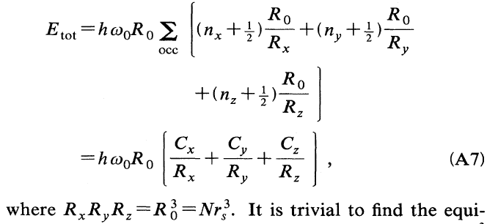
Total energies

Slide 32
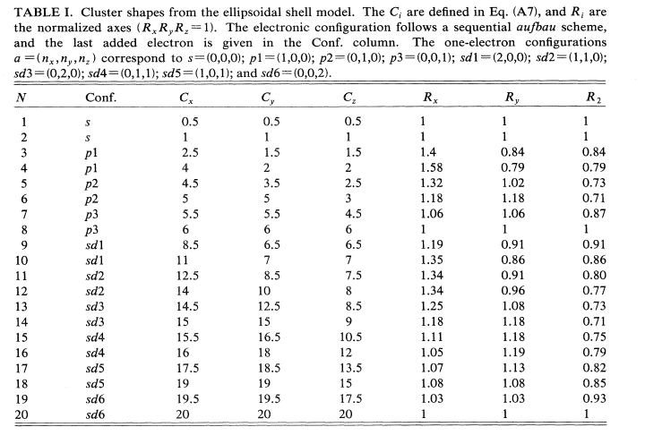

Slide 33
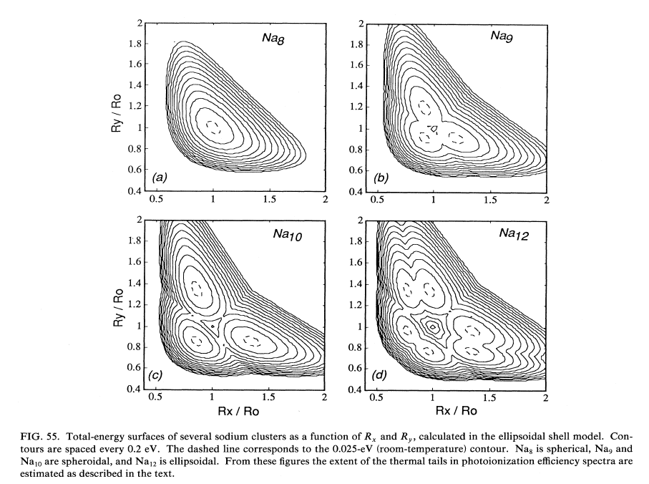
Total energy surfaces

Slide 34
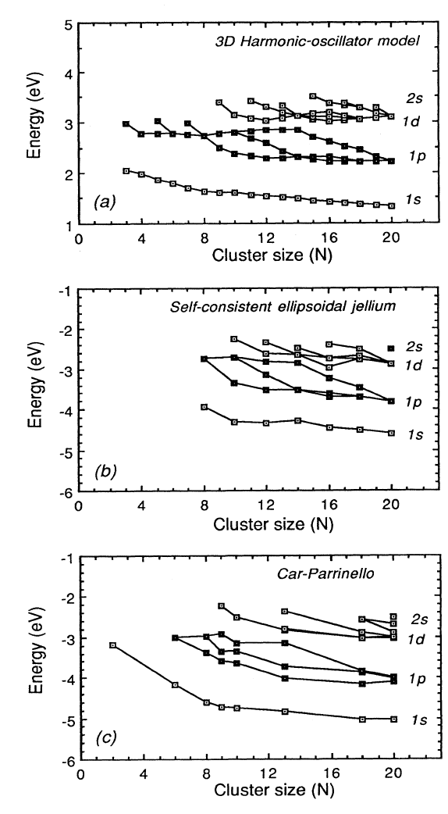

Slide 35
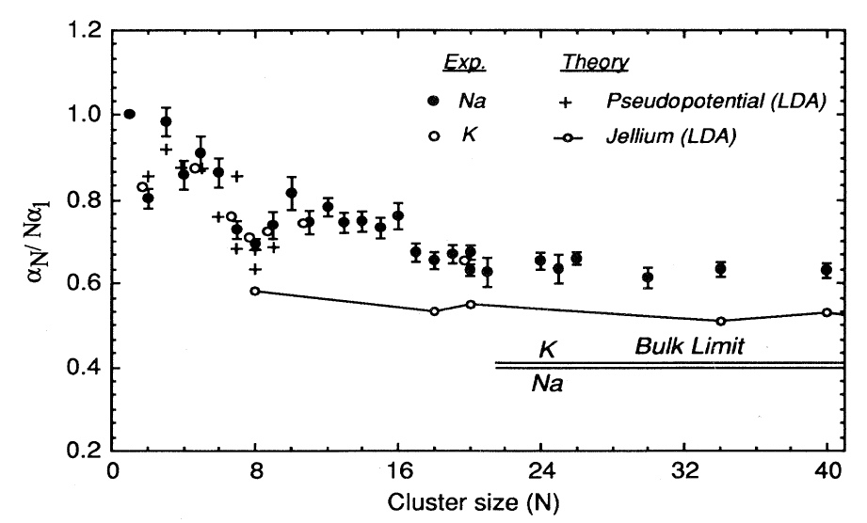
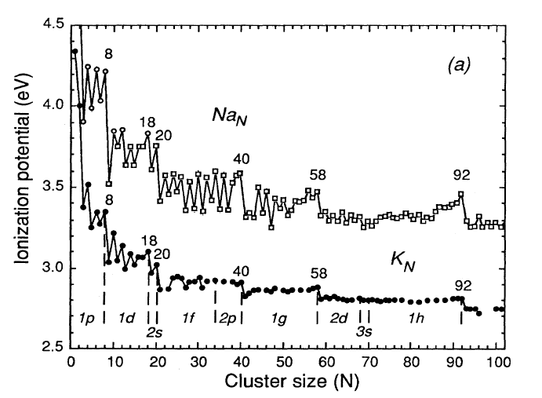
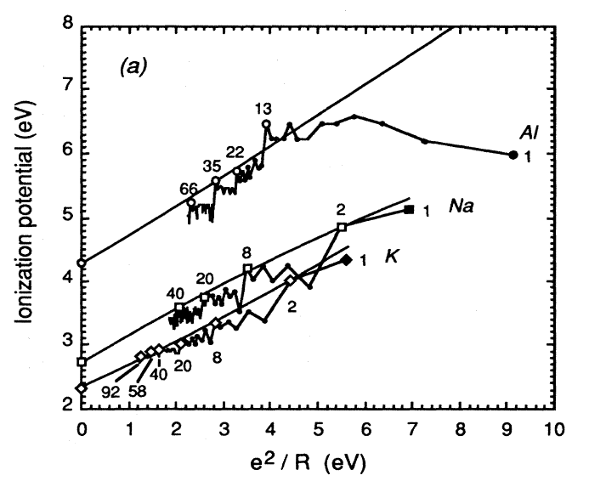
Early measurements of metallic properties of clusters
Polarizabilities (screening)
Ionization potentials (Fermi level, screening )
W.A.de Heer, Rev. Mod. Phys. 65 611, (1993)

Slide 36
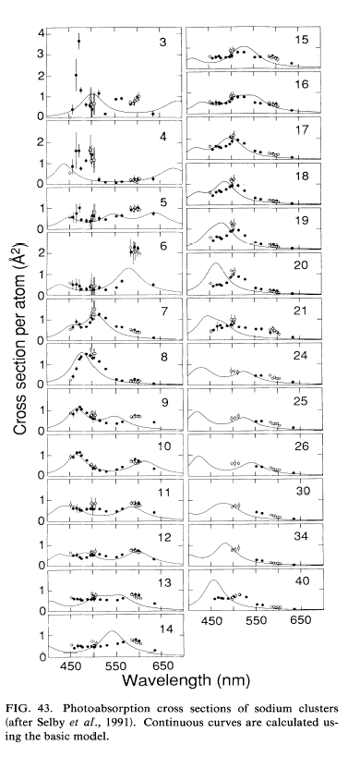
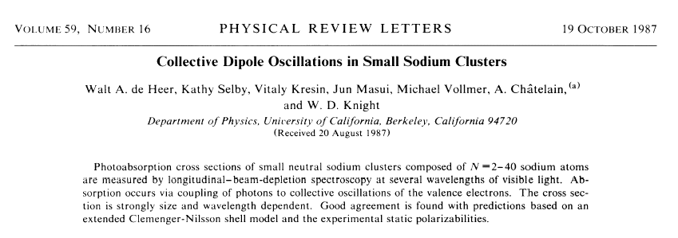
Plasma resonances
(electron-drop dominated shapes)
(multiple peaks reflect non-spherical shapes)
Collective electron oscillations:
(Very intense; almost exhaust the oscillator strength).

Slide 37
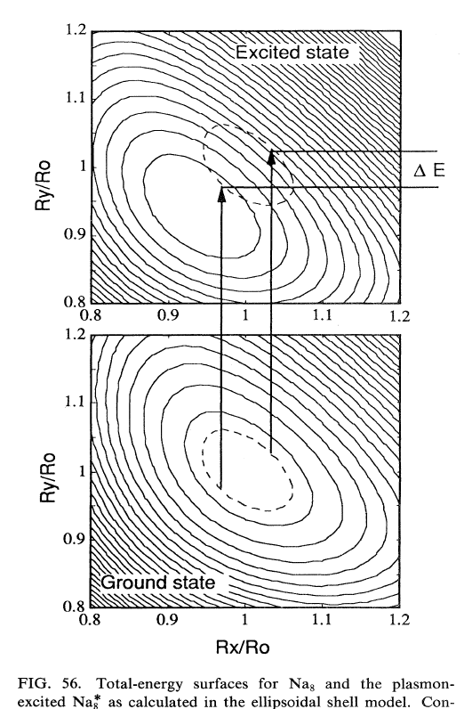
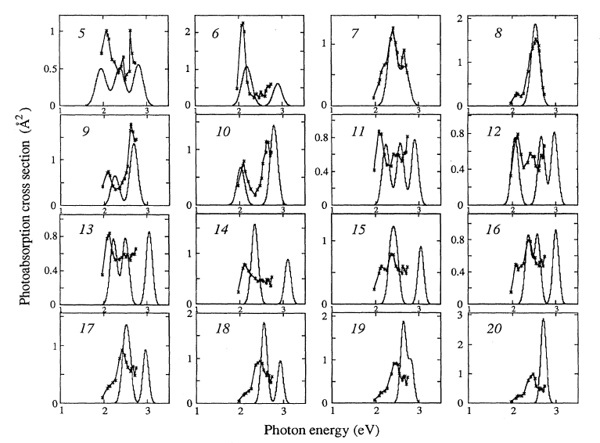
Frank Condon overlap for plasmon excitations using 3D harm. Osc. model

Slide 38
Direct demonstration of electronic shell structure

Slide 39
Frank Condon overlap for photoelectron spectra 3D harm. Osc. model

Slide 40
Shell structure is ubiquitous!
Shell structure in non-simple metals: Indium

Slide 41
Shell structure in non-simple metals: SIMS of zinc and cadmium

Slide 42
Shell structure in non-simple metals: SIMS of the noble metals

Slide 43
Transition to electronic shell structure: Hg_{N}, N>30

Slide 44
More, bigger and better: the TP machine.

Slide 47
Ionization potentials of large Na clusters

Slide 48
Shell structure around a hole:
Alkali coated C₆₀
M. Springborg, S.Satpathy. N. Malinowski, U. Zimmerman, T.P. Martin

Slide 49
More, bigger and better.

Slide 50
Another way to look at it: semi-classical orbits

Slide 51
Shells of shells: Supershell structure

Slide 52
Hitting the limits
Transition from electronic shell structure to geometric shell structure

Slide 53
Geometric shell structure: shells of atoms

Slide 54
Al transitions to jellium but it does not exhibit electronic shell structure.

Slide 55
Shell structure limitations: evolution of s-p hybridization in Al

Slide 56
Al is the quintessential jellium metal in the bulk. But what about clusters?

Slide 58
The End

Slide 62
abstract
Na7, Na19, Na38

Slide 66
The Chemists point of view

